Slide 1
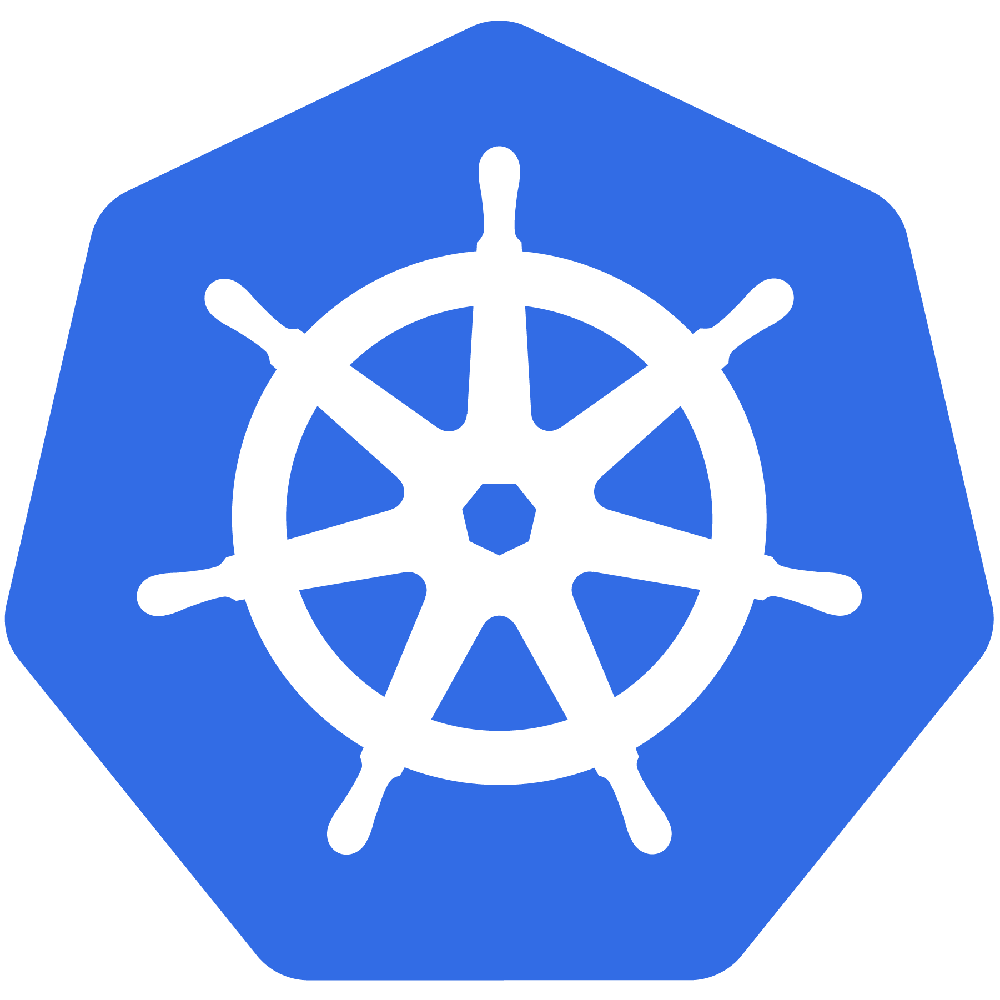
Kubernetes
An Introduction

Slide 2
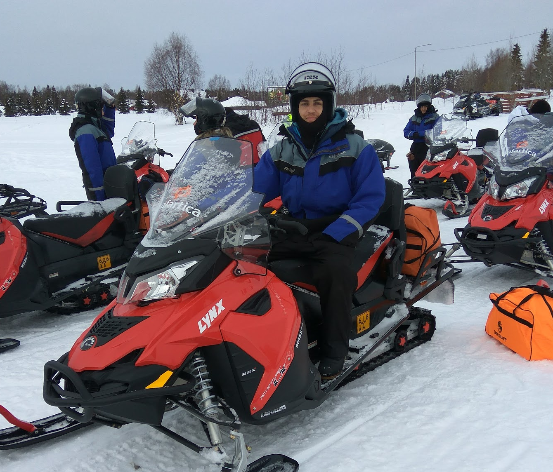
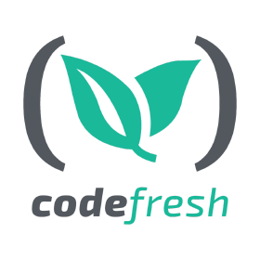

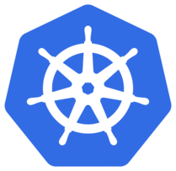

About Me
Oleg Sucharevich
github.com/olegsu

Slide 3

Agenda
Docker recap
Orchestrators
Kubernetes
General
Architecture & API
Entity model

Slide 4
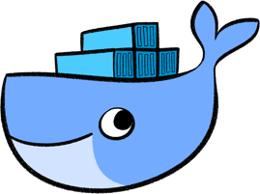

Recap

Slide 5
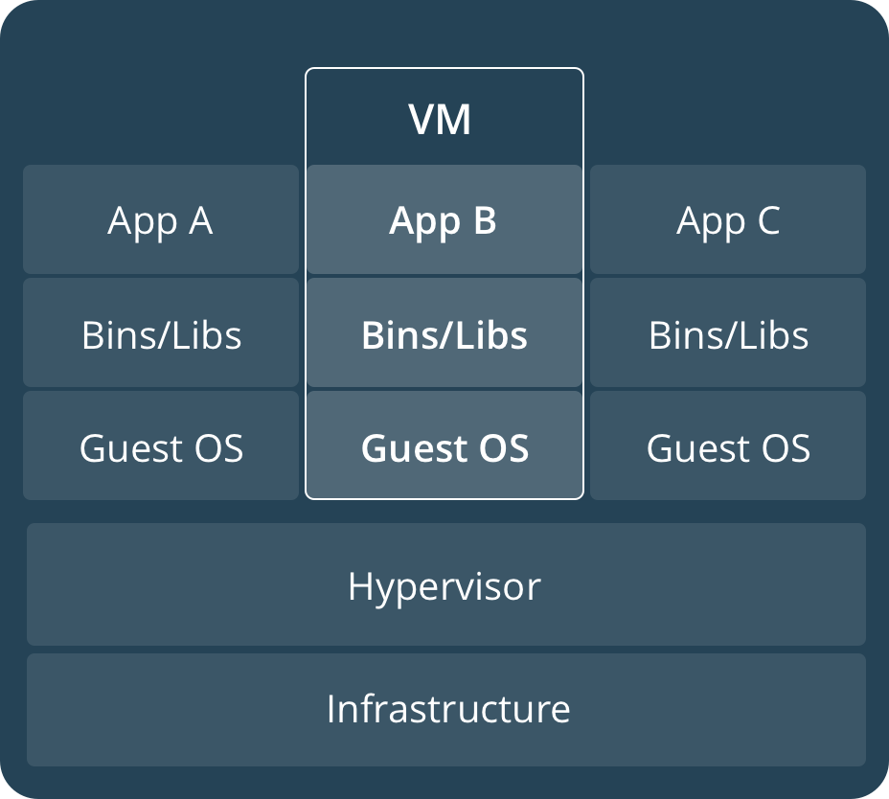
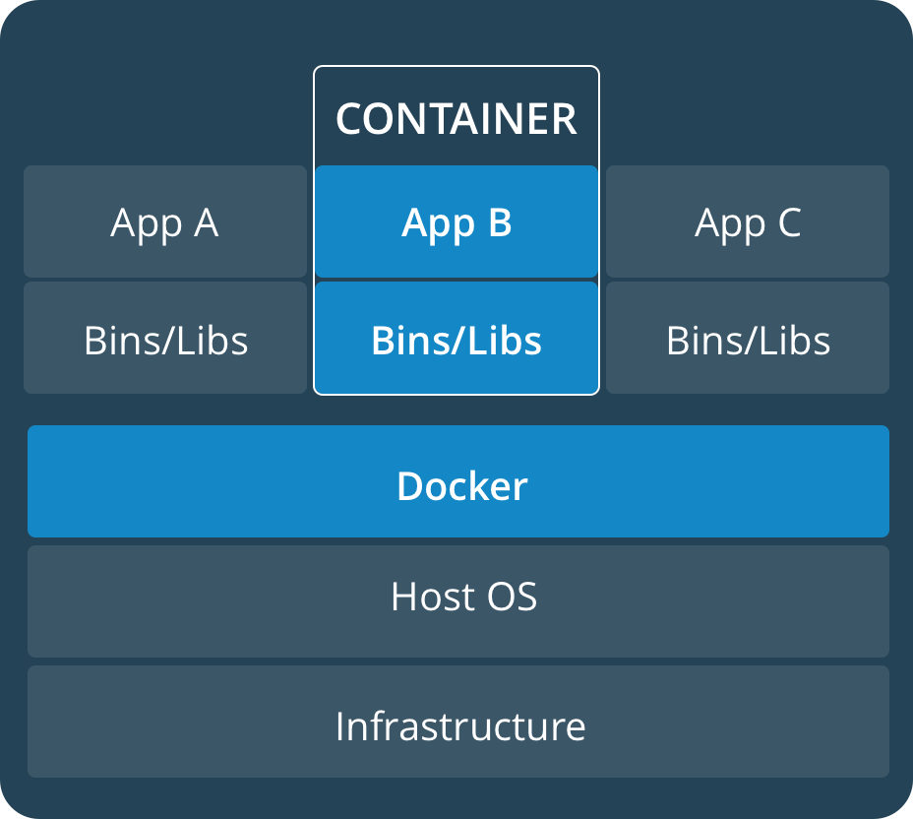
VM VS Container

Slide 6
Concepts
Flexible: Containerize any application.
Lightweight: Share host kernel.
Interchangeable: Update and upgrade on-the-fly.
Portable: Build locally, run anywhere.
Scalable: Increase container replicas.

Slide 7
01 Docker
sudo su - git clone https://github.com/ageapps/docker-chat /workshop/docker-chat cd /workshop/docker-chat docker build -t chat app docker run -d --name db mongo docker run --link db -p 80:3000 -d chat
Notes:
do not forget to clear containers after the session docker rm -f $(docker ps -aq)

Slide 8
Composition
Compose is a tool for defining and running multi-container Docker applications. With Compose, you use a YAML file to configure your application’s services. Then, with a single command, you create and start all the services from your configuration.

Slide 9
02 Composition
Heapster Shop
docker rm -f $(docker ps -aq) git clone https://github.com/olegsu/microservices-demo /workshop/microservices-demo cd /workshop/microservices-demo git checkout docker-compose docker-compose -f composition-manifests/docker-compose.yml up -d

Slide 10
Why we need orchestrators?
Multi nodes
Security
Scale
Resource management
Load balancing
Health check and monitoring

Slide 11
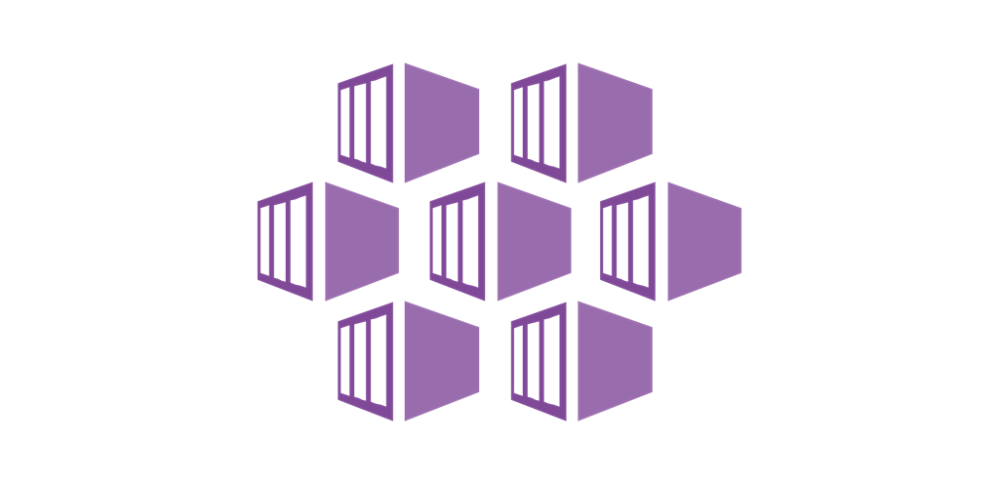
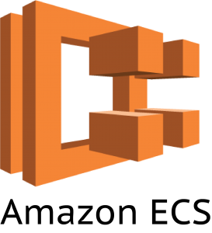

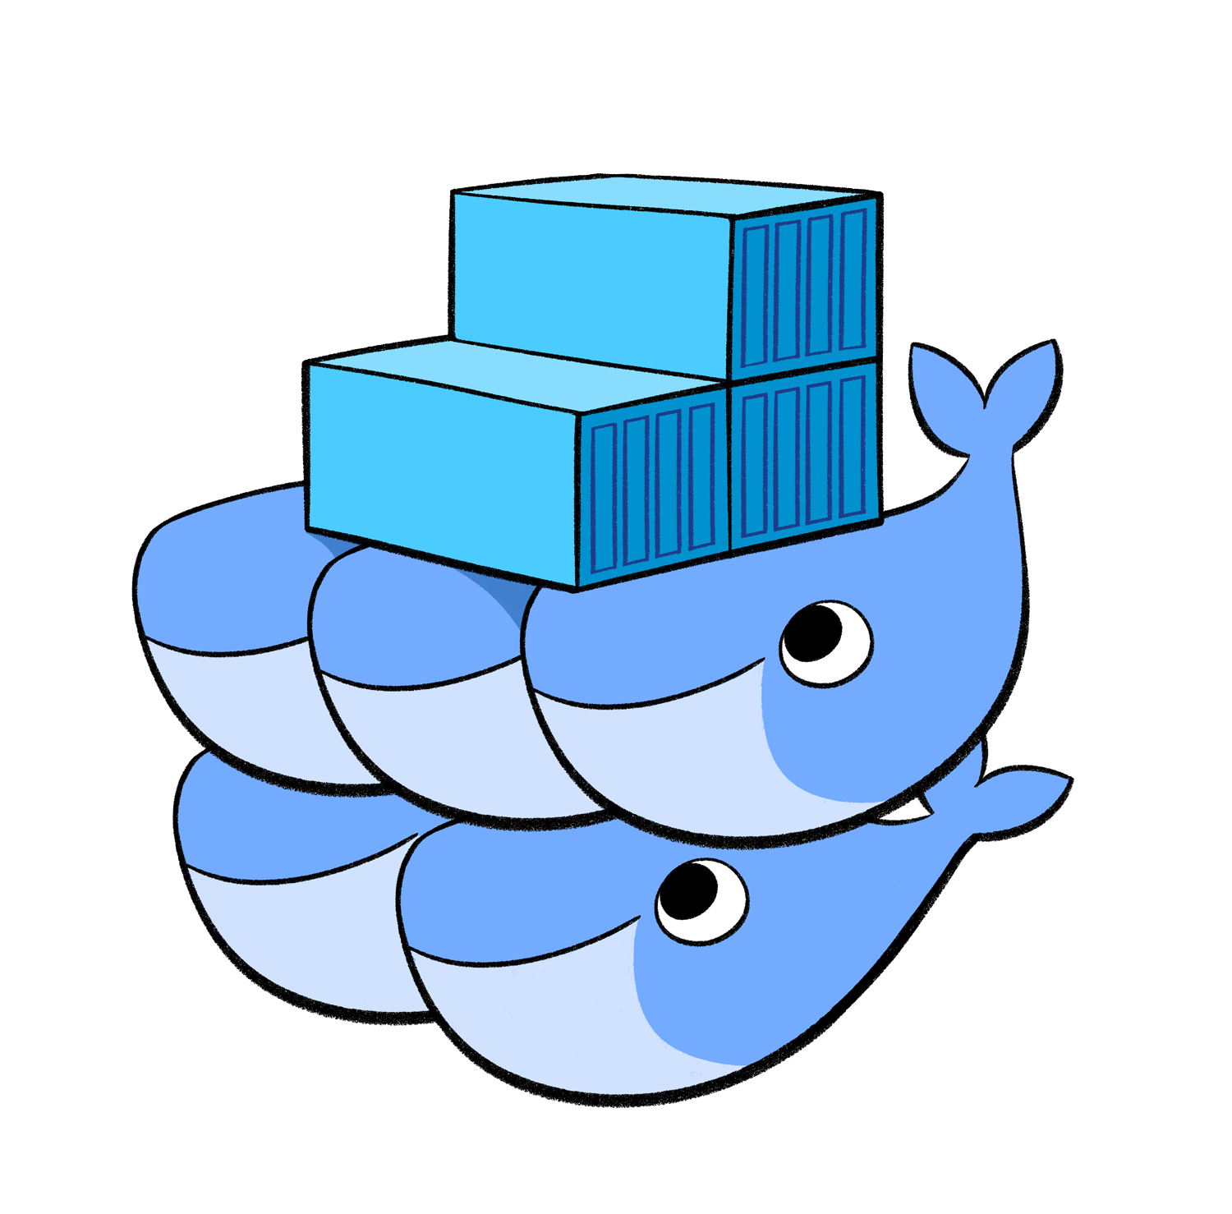
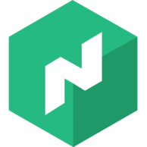
Orchestrators

Slide 12
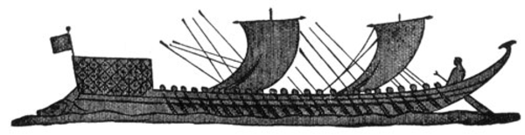
What Does “Kubernetes” Mean?
Greek for “pilot” or
“Helmsman of a ship”

Slide 13
What is Kubernetes?
Project that was spun out of Google as an open source container orchestration platform.
Built from the lessons learned in the experiences of developing and running Google’s Borg and Omega.
Designed from the ground-up as a loosely coupled collection of components centred around deploying, maintaining and scaling workloads.

Slide 14
What Does Kubernetes do?
Known as the linux kernel of distributed systems.
Abstracts away the underlying hardware of the nodes and provides a uniform interface for workloads to be both deployed and consume the shared pool of resources.
Works as an engine for resolving state by converging actual and the desired state of the system.

Slide 15
State machine
Kubernetes will ALWAYS try and steer the cluster to its desired state.
Me: “I want 3 healthy instances of redis to always be running.”
Kubernetes: “Okay, I’ll ensure there are always 3 instances up and running.”
Kubernetes: “Oh look, one has died. I’m going to attempt to spin up a new one.”

Slide 16
What can Kubernetes REALLY do?
Autoscale Workloads
Blue/Green Deployments
Fire off jobs and scheduled cronjobs
Manage Stateless and Stateful Applications
Provide native methods of service discovery
Provide security model using RBAC

Slide 17

Most Importantly...
Use the SAME API across bare metal and EVERY cloud provider!!!

Slide 18

Project Stats
Over 54,000 stars on Github
Over 18,000 forks
2000+ Contributors to K8s Core
Most discussed Repository by a large margin
69,000+ users in Slack Team
10/2018

Slide 19
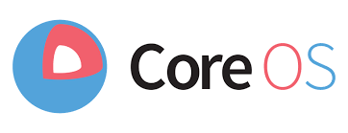



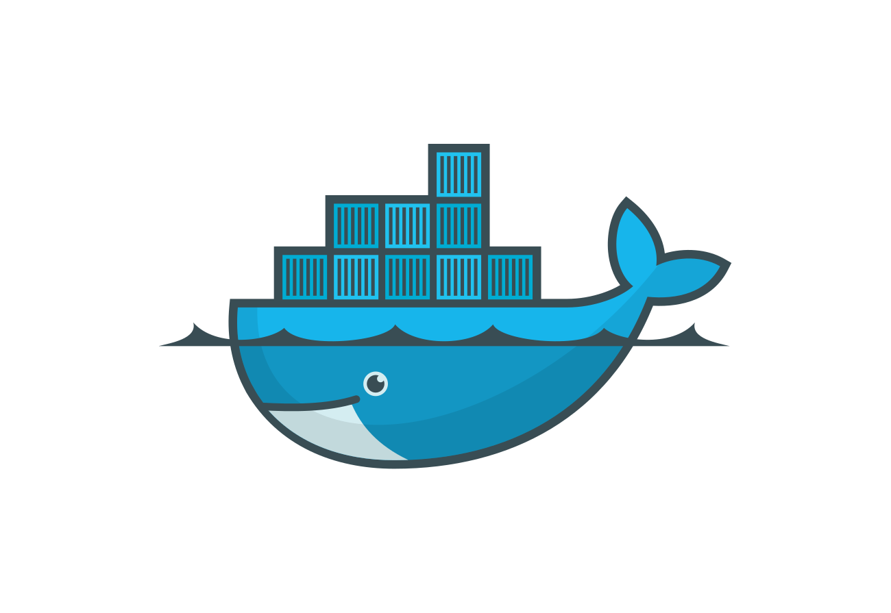




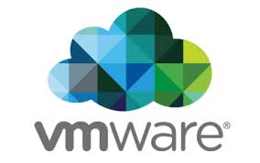


Who Built K8S

Slide 20











Who Uses K8S

Slide 21
Architecture
Overview

Slide 22
03 Kubernetes
git checkout kubernetes kubectl config current-context kubectl apply -f release/kubernetes-manifests.yaml

Slide 23
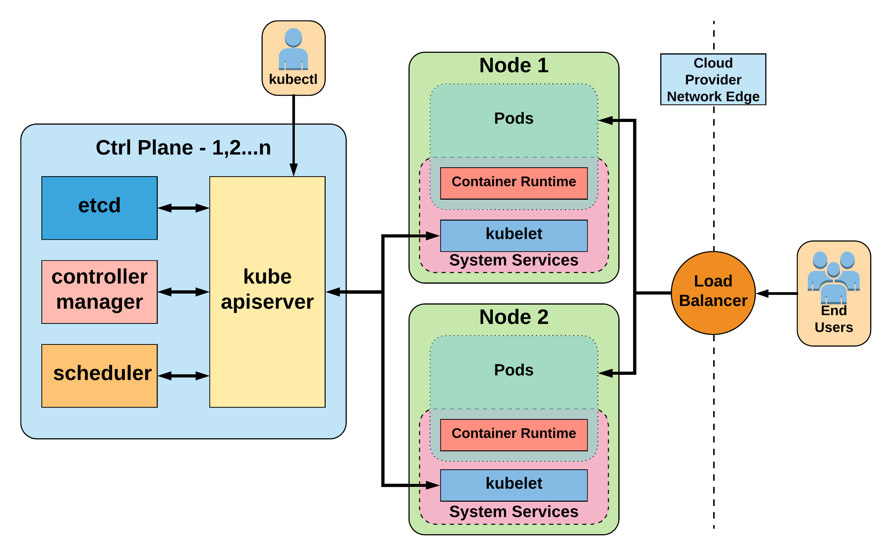

Slide 24
API And Object Model

Slide 25
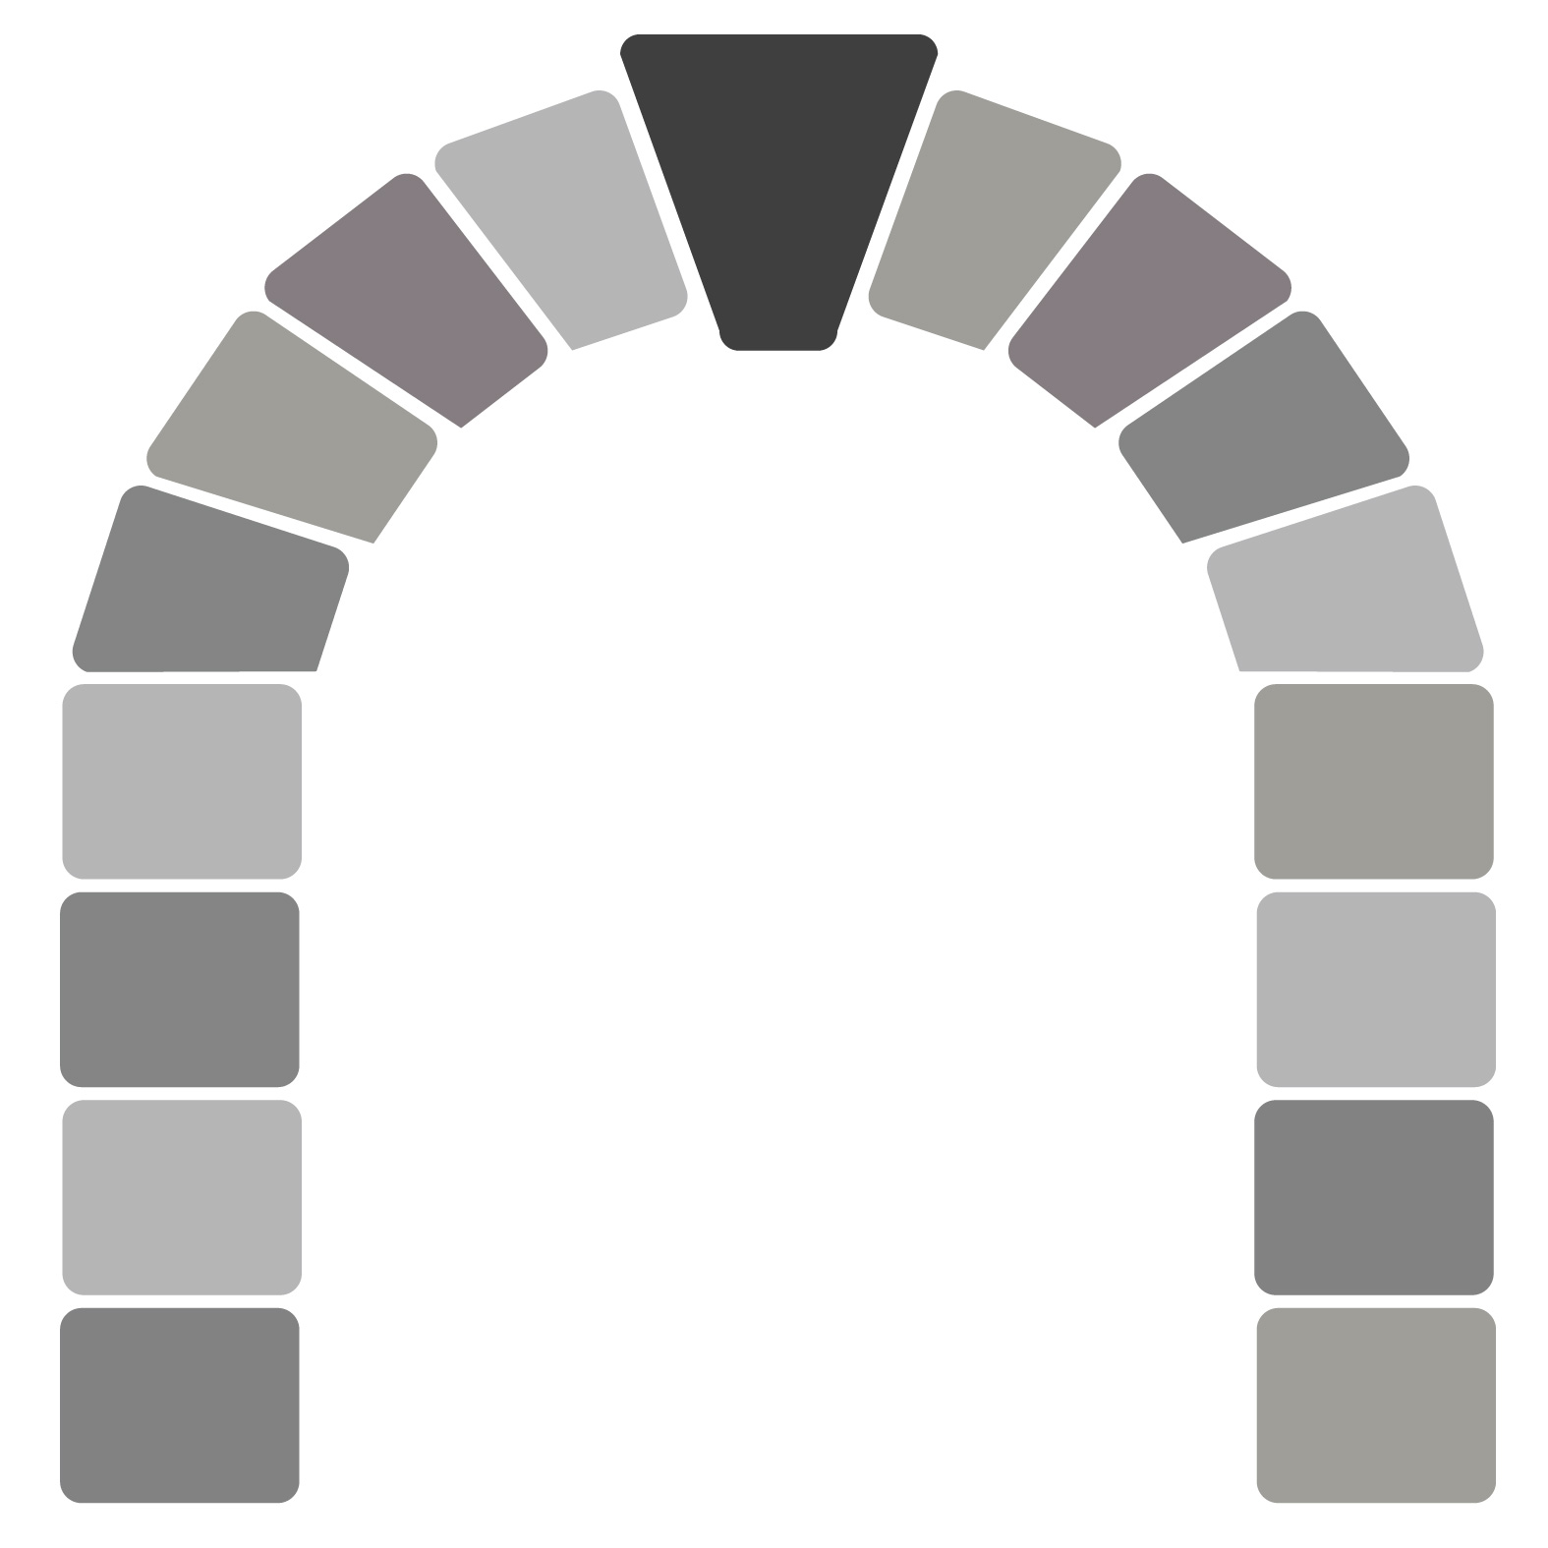
API Overview
The REST API is the true keystone of Kubernetes.
Everything within the Kubernetes is as an API Object.
Image Source

Slide 26
API
Designed to make it extremely simple to both understand and extend.
An API Group is a REST compatible path that acts as the type descriptor for a Kubernetes object.
Referenced within an object as the apiVersion and kind.
Format:
/apis/<group>/<version>/<resource>
Examples:
/apis/apps/v1/deployments
/apis/batch/v1beta1/cronjobs

Slide 27
Object Expression - YAML
YAML - YAML Ain't Markup Language
Files or other representations of Kubernetes Objects are generally represented in YAML.
A “Human Friendly” data serialization standard.
Uses white space (specifically spaces) alignment to denote ownership.
Three basic data types:
mappings - hash or dictionary,
sequences - array or list
scalars - string, number, boolean etc

Slide 28
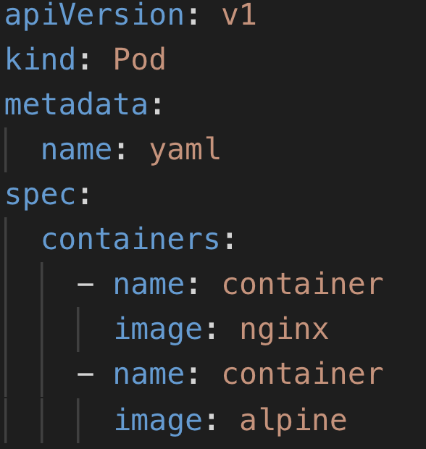
Object Expression - YAML
Scalar
Mapping Hash Dictionary
Sequence Array List

Slide 29
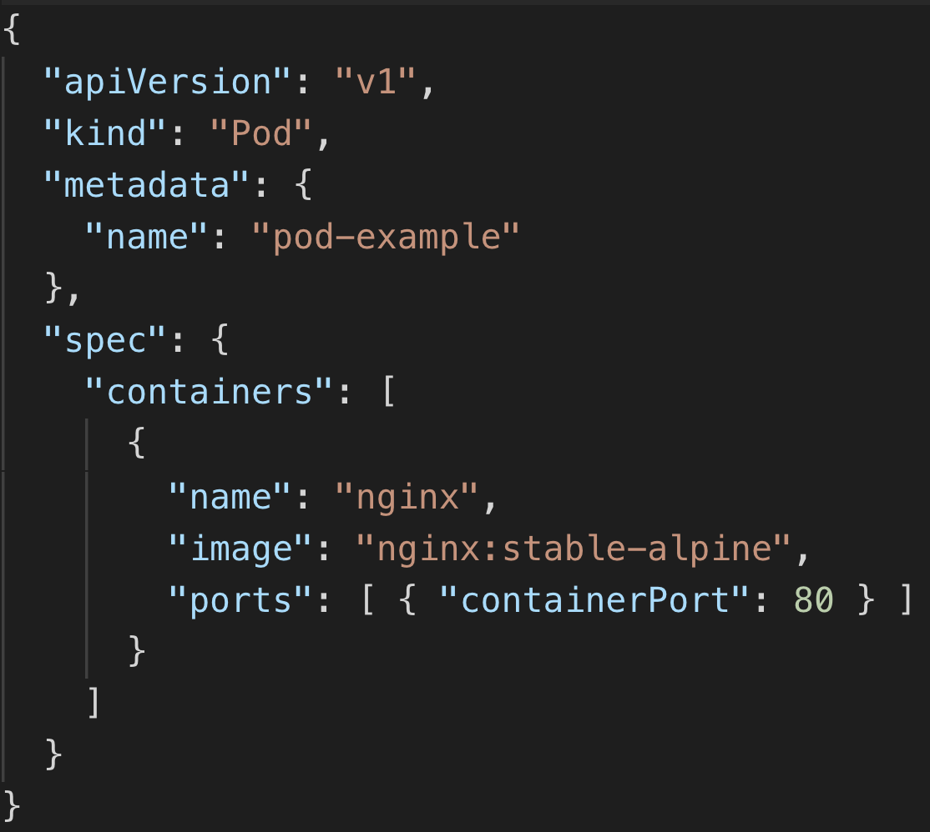
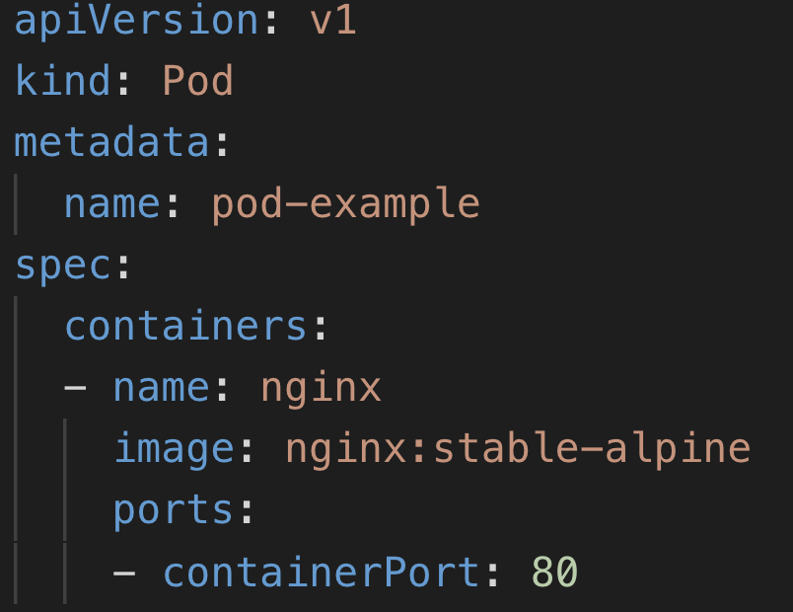
YAML vs JSON

Slide 30
Core
Objects
Namespaces
Pods
Services
Labels
Selectors
Concepts and Resources

Slide 31
Core Concepts
Kubernetes has several core building blocks that make up the foundation of their higher level components.
Namespaces
Pods
Services
Labels
Selectors

Slide 32
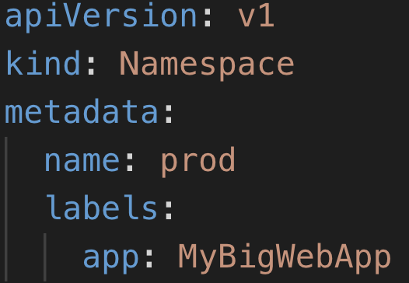
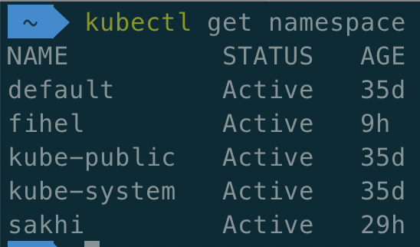
Namespaces
Namespaces are a logical cluster or environment, and are the primary method of partitioning a cluster or scoping access.

Slide 33
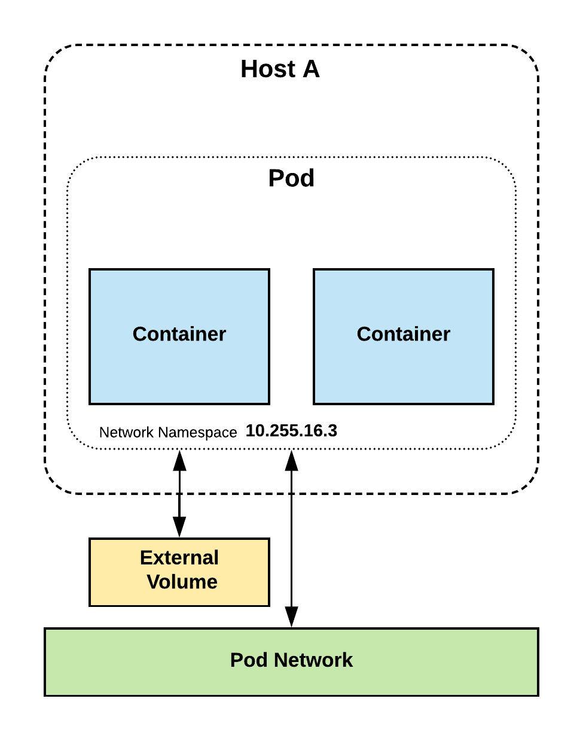
Pod
Atomic unit or smallest “unit of work”of Kubernetes.
Foundational building block of Kubernetes Workloads.
Pods are one or more containers that share volumes, a network namespace, and are a part of a single context.
Running on the same node
Ephemeral

Slide 34
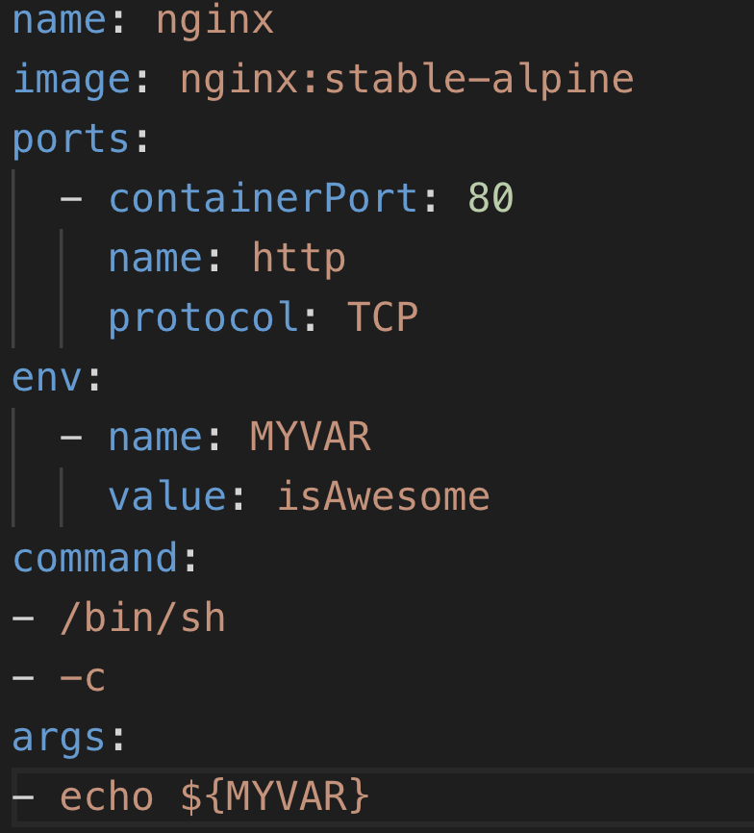
Key Pod Container Attributes
name - The name of the container
image - The container image
ports - array of ports to expose. Can be granted a friendly name and protocol may be specified
env - array of environment variables
command - Entrypoint array (equiv to Docker ENTRYPOINT)
args - Arguments to pass to the command (equiv to Docker CMD)

Slide 35
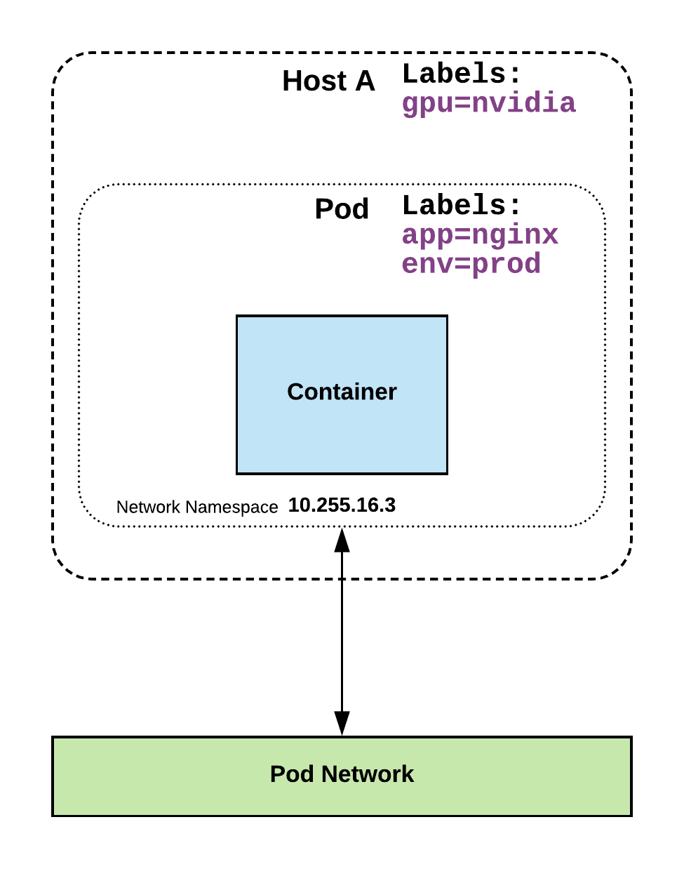
Labels
key-value pairs that are used to identify, describe and group together related sets of objects or resources.
kubectl get namespace --selector nwd.workshop=true

Slide 36
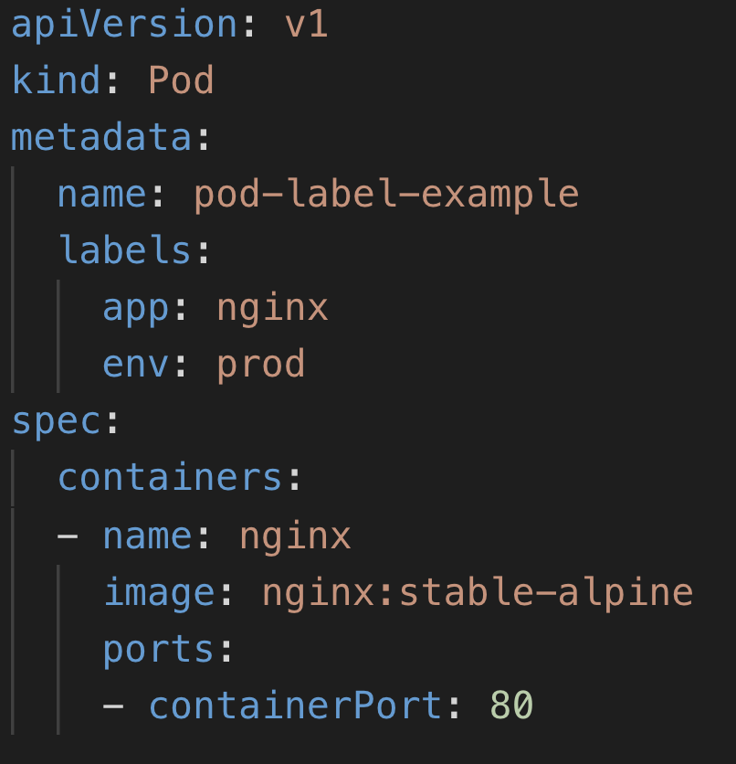
Label Example

Slide 37
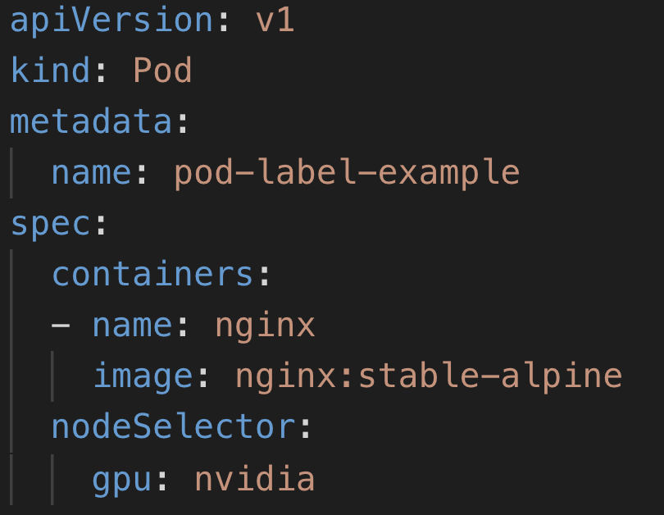
Selectors
Selectors use labels to filter or select objects, and are used throughout Kubernetes.

Slide 38
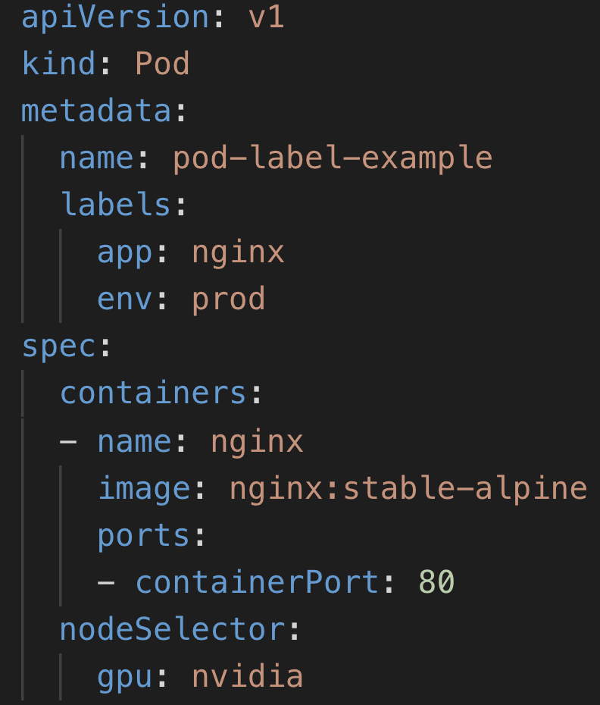
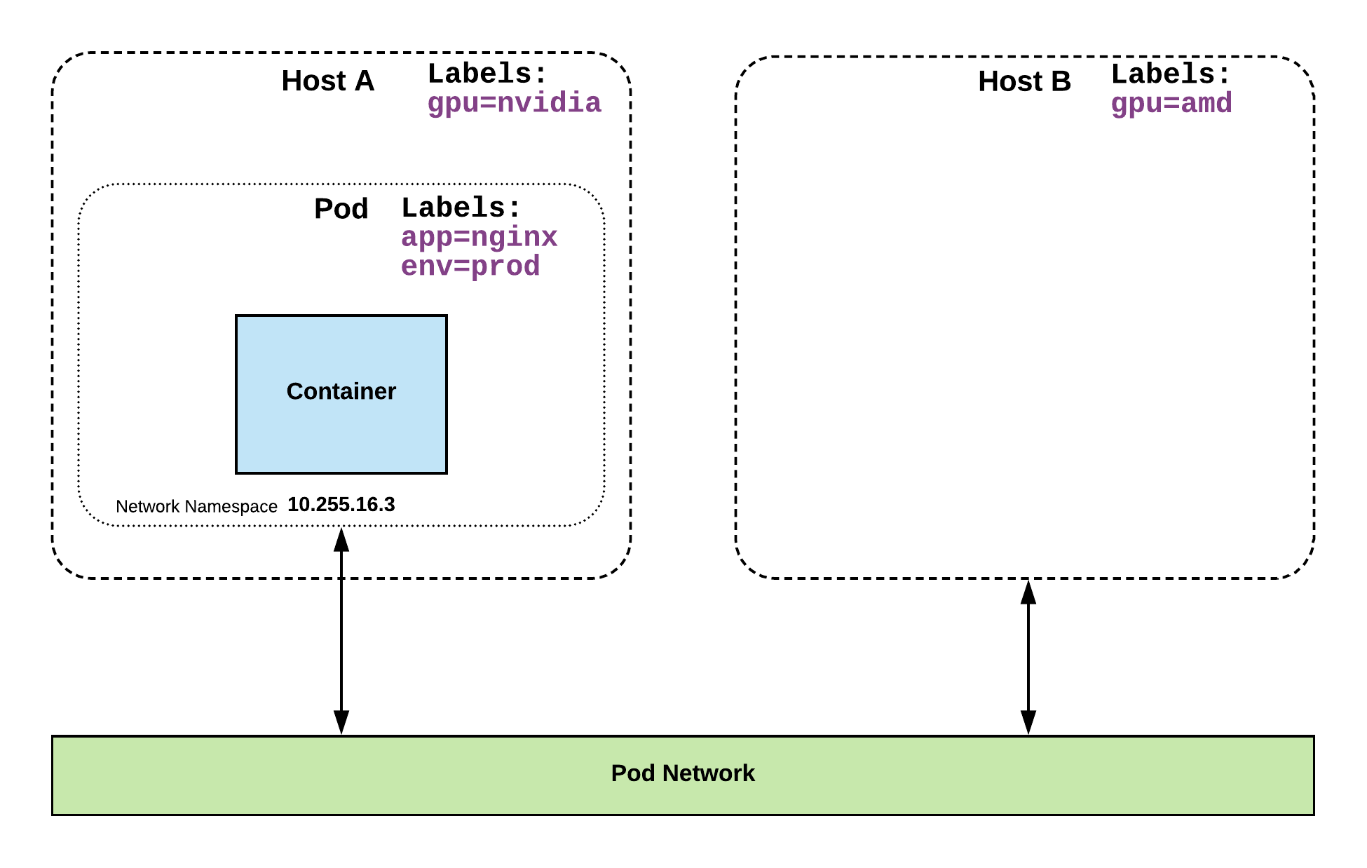
Selector Example

Slide 39
04 Kubernetes (pod)
kubectl get pods kubectl describe pods <NAME> kubectl get pods -o yaml <NAME>

Slide 40
Services
Unified method of accessing the exposed workloads of Pods.
Durable resource (unlike Pods)
static cluster-unique IP
static namespaced DNS name
<service name>.<namespace>.svc.cluster.local

Slide 41
05 Kubernetes(service)
kubectl get service -o wide kubectl describe service <NAME>

Slide 42
Workloads
ReplicaSet
Deployment
Concepts and Resources

Slide 43
Workloads
Workloads within Kubernetes are higher level objects that manage Pods or other higher level objects.
In ALL CASES a Pod Template is included, and acts the base tier of management.

Slide 44
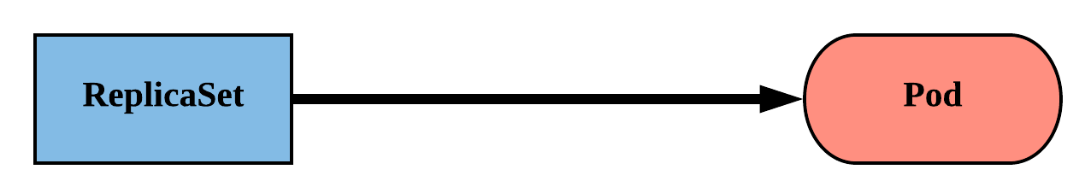
ReplicaSet
Primary method of managing pod replicas and their lifecycle.
Includes their scheduling, scaling, and deletion.
Their job is simple: Always ensure the desired number of pods are running.

Slide 45
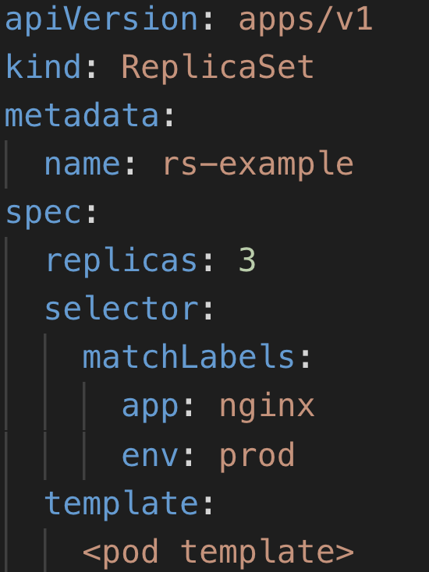
ReplicaSet
replicas: The desired number of instances of the Pod.
selector:The label selector for the ReplicaSet will manage ALL Pod instances that it targets; whether it’s desired or not.

Slide 46
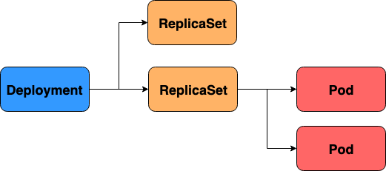
Deployment
Declarative method of managing Pods via ReplicaSets.
Provide rollback functionality and update control.
Each iteration creates a unique label that is assigned to both the ReplicaSet and subsequent Pods.

Slide 47
06 Kubernetes (scale)
kubectl scale deployment currencyservice --replicas 2 kubectl delete pods <NAME> kubectl scale deployment currencyservice --replicas 1
sudo su - watch kubectl get pods

Slide 48
07 Kubernetes (upgrade)
git checkout regression kubectl apply -f release/kubernetes-manifests.yaml kubectl get pods kubectl get deployment

Slide 49
08 Kubernetes (rollback)
kubectl rollout history deployment/shippingservice kubectl rollout undo deployment/shippingservice kubectl rollout history deployment/shippingservice

Slide 50
Summary
Ecosystem
Architecture
API and Entity Model
Out-of-the-box features

Slide 51
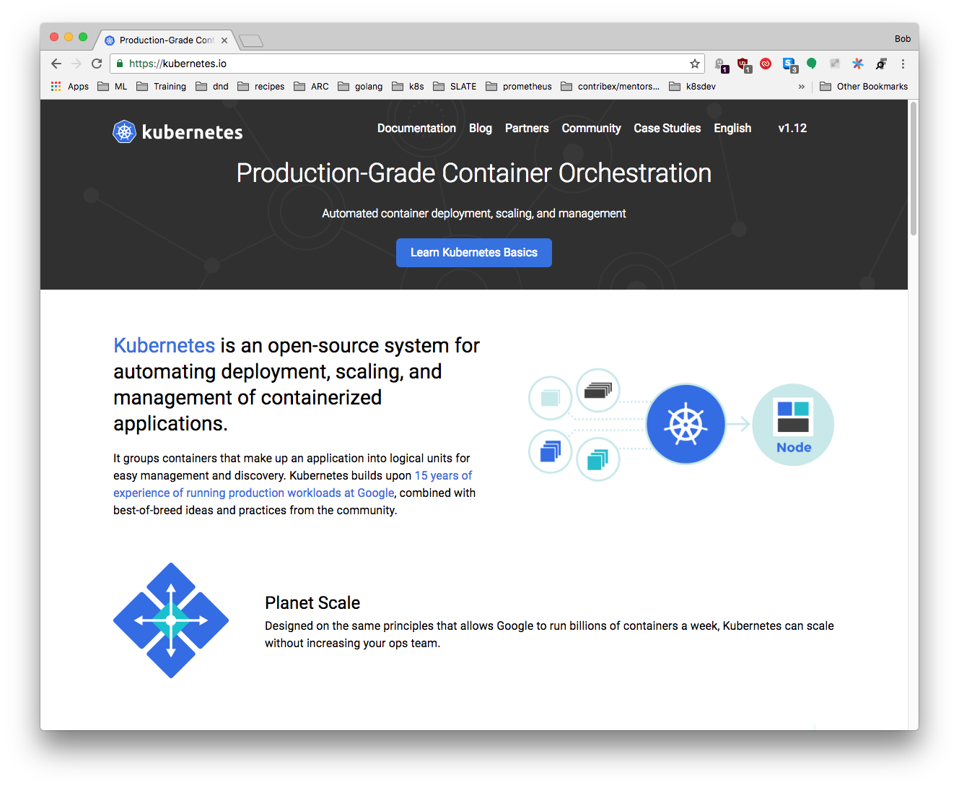
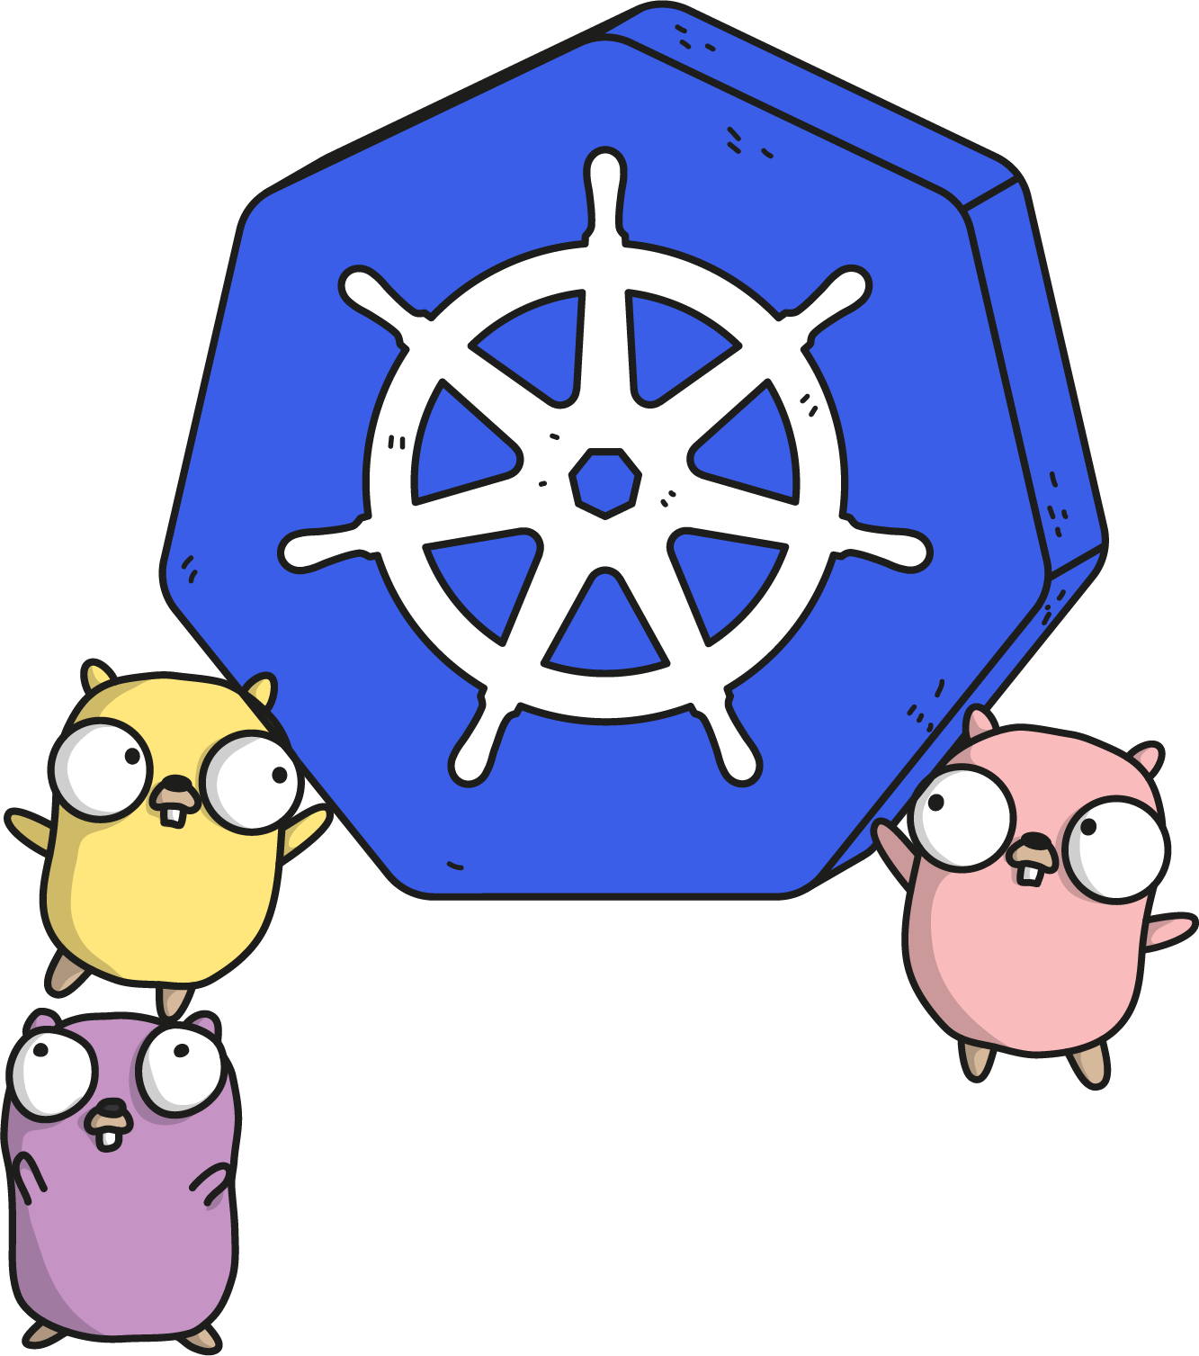
kubernetes.io
Documentation
Examples
API Reference

Slide 52
Links
TGI Kubernetes on Youtube
Official forum https://discuss.kubernetes.io
Kubernetes Slack https://slack.k8s.io/
CNCF Youtube channel with Kubecon lecture

Slide 53
Thank you

